Slide 1

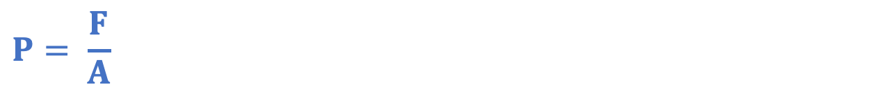
Taking it Further: Pressure in Fluids
Answer the questions below.
Define a fluid.
State the equation used to calculate pressure.
Name the property of liquids that makes them useful for hydraulics.
What does the $g$ represent in the equation $W=mg$?
What are the units for the quantity $g$?
A substance with no fixed shape.
$$P= \frac{F}{A}$$
They cannot be compressed.
Gravitational field strength
N/kg
Notes:
Big idea: Energy is conserved
Foundation: What is density?
Stretch: What are the different units that could be used to measure density?
Answers:
Foundation: The mass per unit volume.
Stretch: g/cm³, kg/m³

Slide 2
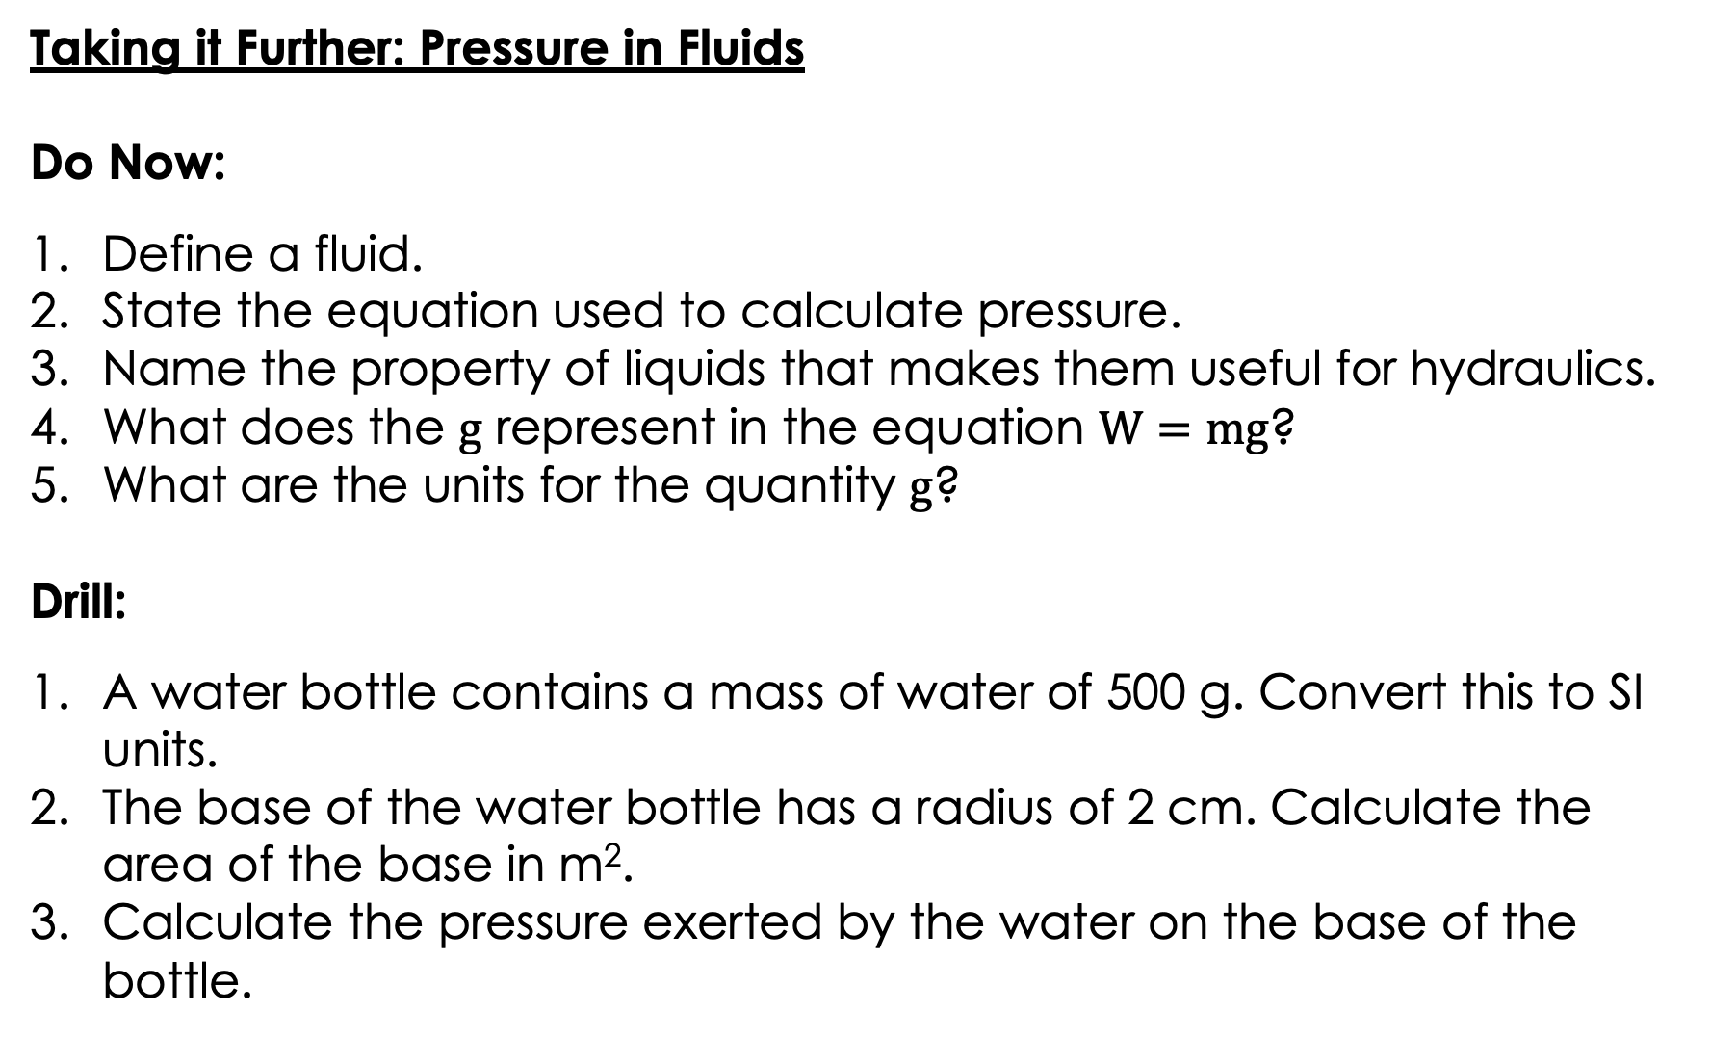
Taking it Further: Pressure in Fluids
Do Now:
Define a fluid.
State the equation used to calculate pressure.
Name the property of liquids that makes them useful for hydraulics.
What does the $g$ represent in the equation $W=mg$?
What are the units for the quantity $g$?
Drill:
A water bottle contains a mass of water of 500 g. Convert this to SI units.
The base of the water bottle has a radius of 2 cm. Calculate the area of the base in m².
Calculate the pressure exerted by the water on the base of the bottle.
Notes:
Drill answers
0.5 kg
1.26 x10⁻³ m²
0.5 kg x 10 = 5 N
P = F/A
P = 3 978.87 N/m² or Pa

Slide 3
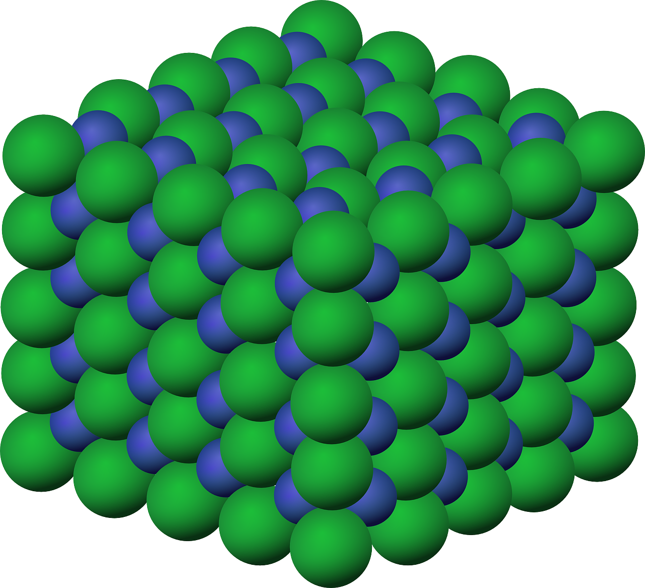
P4.1.6
04/12/2025
Taking it Further:
Pressure in Fluids
P4.1.1 Prior Knowledge Review
P4.1.2 Density
P4.1.3 Measuring Density
P4.1.4 Gas Pressure
P4.1.5 Taking it Further: Pressure
P4.1.6 Taking it Further: Pressure in Fluids
Notes:
Big Idea: Energy is Conserved.
This lesson builds on the previous lesson of physics only content, looking at the relationship between pressure and depth/height in a fluid.
Suggested Hook:
The easiest way to show students the key ideas behind this lesson is with a bottle of water with three holes at different heights, to observe how water is pushed out of the hole at each different height.
Alternatively, the blobfish is an engaging example to start with.
https://www.smithsonianmag.com/smart-news/in-defense-of-the-blobfish-why-the-worlds-ugliest-animal-isnt-as-ugly-as-you-think-it-is-6676336/

Slide 4

Following this lesson, students will be able to:
Describe and explain the relationship between pressure and depth of a fluid
Calculate the pressure exerted on an object at different depths
Describe the forces acting on an object when they float or sink
Key Words:
depth
height
density
gravitational field strength
upthrust
altitude
Notes:
Guidance:
See unit overview document and planning guidance to see how these objectives are typically assessed at GCSE, including examples of what students should be able to do following this lesson.
Planning for different needs:
The learning objectives given on this slide are suggested based on the most common requirements for exams, however they can be adapted based on the needs of different classes.
For best practice, the unit preparation booklet should be used to determine the appropriate focus of lessons within the unit.
While it is not possible to explicitly split content into levelled grades, we recommend that lesson objectives can be classified as critical, core or stretch.
Critical: the content or skill is essential for all students to be able to progress.
Core: the content or skill is important for students to progress, but other opportunities may be available to revisit it.
Stretch: the content or skill may not be essential for all students but is important for students aiming for the highest grades.
Key skill: this is a crucial skill being developed in this unit as part of the skill mapping
P4.1.6 Lesson Objectives:
Critical: Calculate the pressure exerted on an object at different depths
Core: Describe and explain the relationship between pressure and depth of a fluid
Stretch: Describe the forces acting on an object when they float or sink

Slide 5
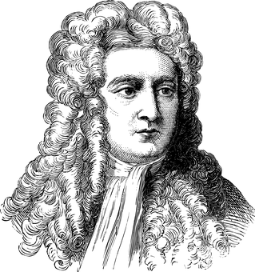
What is the difference between mass and weight?
The mass of an object is the amount of __________ it contains.
Units of mass = kilograms (measured using a __________)
The mass of an object does not change unless material is _________ or ____________ from the object.
Units of weight = Newtons (measured using a __________)
Weight is the _________ of gravity acting on a mass.
Notes:
These first two slides can be used as a recap of the difference between mass and weight, linking to understanding what g is, which students will need for this lesson.
Suggested exposition:
Mass is how much ‘stuff’ an object contains / is made of – the total amount of matter it contains. To change the mass of an object you would have to add or remove matter (e.g. amputate a leg - a quite severe example to illustrate the point!).
Weight is how strongly gravity attracts that mass. Weight is a force.
What is a force?
A push, pull or twist that can change the shape, speed or direction of an object.
In which direction does gravity pull everything?
Towards the centre of the Earth.
Which way does weight act or ‘pull’?
Towards the centre of the Earth. (if students answer: ‘down’, ask them which way is down in Australia?)
If I changed your mass by e.g. cutting off arm/ leg etc, would this change your weight?
Yes.
Why?
Weight is the force of gravity acting on a mass, so changing the mass would change the weight.
What if I pulled out a hair?
Students are often less certain about this, believing that a small mass will make no difference, but it does, for the same reason as cutting off a leg!
Is it possible to change your weight without changing your mass?
Yes. Go to the Moon, or another planet, where the force of gravity is different.
Image source: pixabay

Slide 6
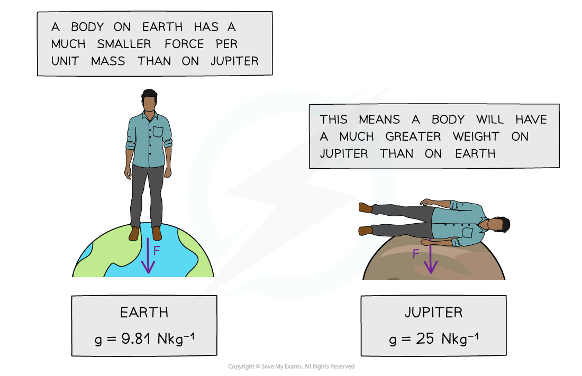
Gravitational field strength
Notes:
Suggested exposition:
Weight is the force of gravity acting on a mass and can be calculated using the equation:
Weight = mass x gravitational field strength
Gravitational field strength is the force exerted per unit of mass. Near the surface of the Earth, the gravitational field strength is approximately 10 N/kg (Newtons per kilogram). This means an object with a mass of 1 kg would be attracted towards the centre of the Earth by a force of 10 N.
Notes:
Gravitational field strength is rounded to 10 N/kg. It is actually approximately 9.8 N/kg. This can also be written as 9.8 m/s² because this is the acceleration due to gravity (an object in free fall, i.e. where gravity is the only force acting) causes objects to accelerate towards the Earth at 9.8 m/s². For the purposes of KS3 and GCSE physics, g will be approximated to 10 N/kg, which makes calculations much easier! W = mg is also the source of common easy marks being lost at GCSE where pupils forget to calculate weight before calculating a resultant force or using it for other calculations, so it is crucial at this point to emphasise that weight is a force. In higher levels of physics, pupils will also be penalised for using gravity rather than weight in free body/force diagrams but at this level either is acceptable.
You may wish to model this equation rather than using the slide. This slide explains how to calculate the weight of an object. It is important to emphasise the layout of the response, including the units in the calculation and lining up the = signs to make the working out easy to read.
There is a separate worksheet which can be completed during the activity stage of the lesson where students can practice using the equation.
Image source: pixabay

Slide 7
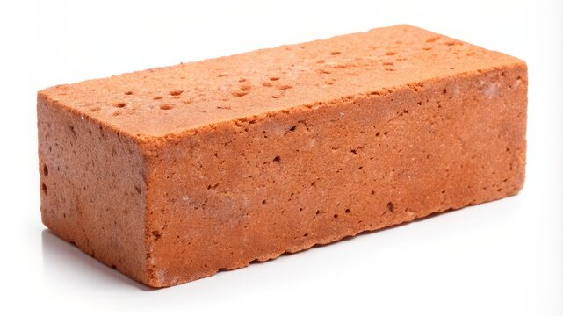
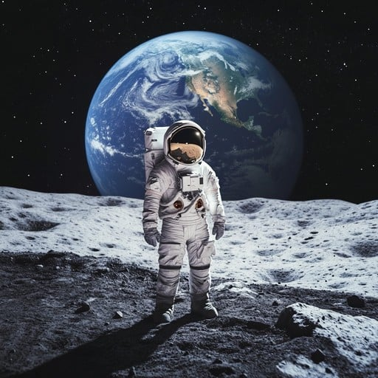
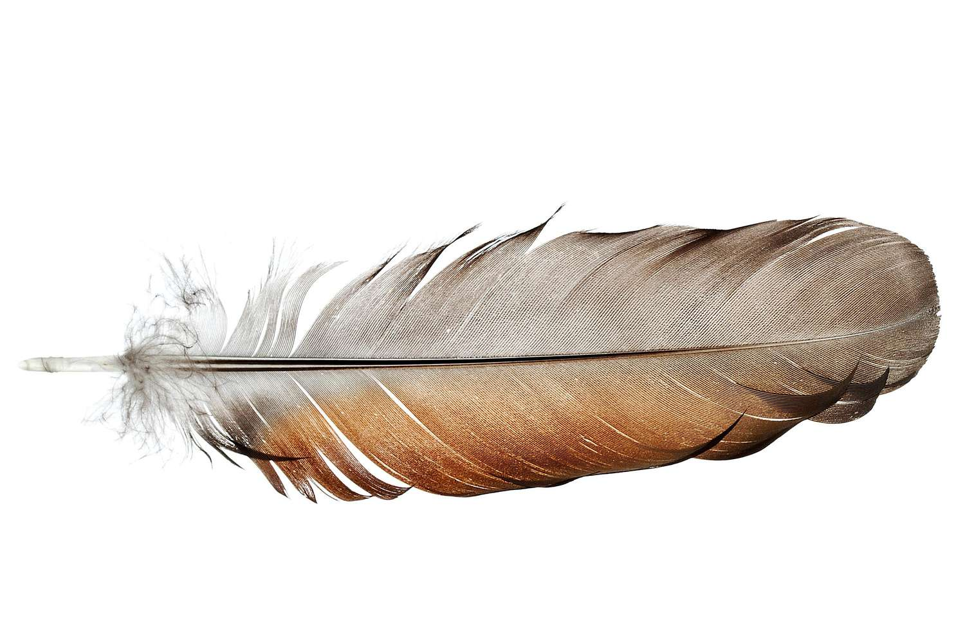
Which one is the odd one out
Notes:
Suggested exposition:
Weight is the force of gravity acting on a mass and can be calculated using the equation:
Weight = mass x gravitational field strength
Gravitational field strength is the force exerted per unit of mass. Near the surface of the Earth, the gravitational field strength is approximately 10 N/kg (Newtons per kilogram). This means an object with a mass of 1 kg would be attracted towards the centre of the Earth by a force of 10 N.
Notes:
Gravitational field strength is rounded to 10 N/kg. It is actually approximately 9.8 N/kg. This can also be written as 9.8 m/s² because this is the acceleration due to gravity (an object in free fall, i.e. where gravity is the only force acting) causes objects to accelerate towards the Earth at 9.8 m/s². For the purposes of KS3 and GCSE physics, g will be approximated to 10 N/kg, which makes calculations much easier! W = mg is also the source of common easy marks being lost at GCSE where pupils forget to calculate weight before calculating a resultant force or using it for other calculations, so it is crucial at this point to emphasise that weight is a force. In higher levels of physics, pupils will also be penalised for using gravity rather than weight in free body/force diagrams but at this level either is acceptable.
You may wish to model this equation rather than using the slide. This slide explains how to calculate the weight of an object. It is important to emphasise the layout of the response, including the units in the calculation and lining up the = signs to make the working out easy to read.
There is a separate worksheet which can be completed during the activity stage of the lesson where students can practice using the equation.
Image source: pixabay

Slide 8
Which one could be the odd one out
Notes:
Suggested exposition:
Weight is the force of gravity acting on a mass and can be calculated using the equation:
Weight = mass x gravitational field strength
Gravitational field strength is the force exerted per unit of mass. Near the surface of the Earth, the gravitational field strength is approximately 10 N/kg (Newtons per kilogram). This means an object with a mass of 1 kg would be attracted towards the centre of the Earth by a force of 10 N.
Notes:
Gravitational field strength is rounded to 10 N/kg. It is actually approximately 9.8 N/kg. This can also be written as 9.8 m/s² because this is the acceleration due to gravity (an object in free fall, i.e. where gravity is the only force acting) causes objects to accelerate towards the Earth at 9.8 m/s². For the purposes of KS3 and GCSE physics, g will be approximated to 10 N/kg, which makes calculations much easier! W = mg is also the source of common easy marks being lost at GCSE where pupils forget to calculate weight before calculating a resultant force or using it for other calculations, so it is crucial at this point to emphasise that weight is a force. In higher levels of physics, pupils will also be penalised for using gravity rather than weight in free body/force diagrams but at this level either is acceptable.
You may wish to model this equation rather than using the slide. This slide explains how to calculate the weight of an object. It is important to emphasise the layout of the response, including the units in the calculation and lining up the = signs to make the working out easy to read.
There is a separate worksheet which can be completed during the activity stage of the lesson where students can practice using the equation.
Image source: pixabay

Slide 9

Calculating weight
Weight can be calculated using the equation:
Near the surface of the Earth the gravitational field strength is approximately 9.8 N/kg, although this is often rounded to 10 N/kg.
Weight (N) = mass (kg) x gravitational field strength (N/kg)
Example:
What is the weight of a 50 kg object sitting on the surface of the Earth? (gravitational field strength = 10 N/kg)
mass = 50 kg
gravitational field strength = 10 N/kg
W = m x g
W = 50 kg x 10 N/kg
W = 500 N
Notes:
Suggested exposition:
Weight is the force of gravity acting on a mass and can be calculated using the equation:
Weight = mass x gravitational field strength
Gravitational field strength is the force exerted per unit of mass. Near the surface of the Earth, the gravitational field strength is approximately 10 N/kg (Newtons per kilogram). This means an object with a mass of 1 kg would be attracted towards the centre of the Earth by a force of 10 N.
Notes:
Gravitational field strength is rounded to 10 N/kg. It is actually approximately 9.8 N/kg. This can also be written as 9.8 m/s² because this is the acceleration due to gravity (an object in free fall, i.e. where gravity is the only force acting) causes objects to accelerate towards the Earth at 9.8 m/s². For the purposes of KS3 and GCSE physics, g will be approximated to 10 N/kg, which makes calculations much easier! W = mg is also the source of common easy marks being lost at GCSE where pupils forget to calculate weight before calculating a resultant force or using it for other calculations, so it is crucial at this point to emphasise that weight is a force. In higher levels of physics, pupils will also be penalised for using gravity rather than weight in free body/force diagrams but at this level either is acceptable.
You may wish to model this equation rather than using the slide. This slide explains how to calculate the weight of an object. It is important to emphasise the layout of the response, including the units in the calculation and lining up the = signs to make the working out easy to read.
There is a separate worksheet which can be completed during the activity stage of the lesson where students can practice using the equation.
Image source: pixabay

Slide 10
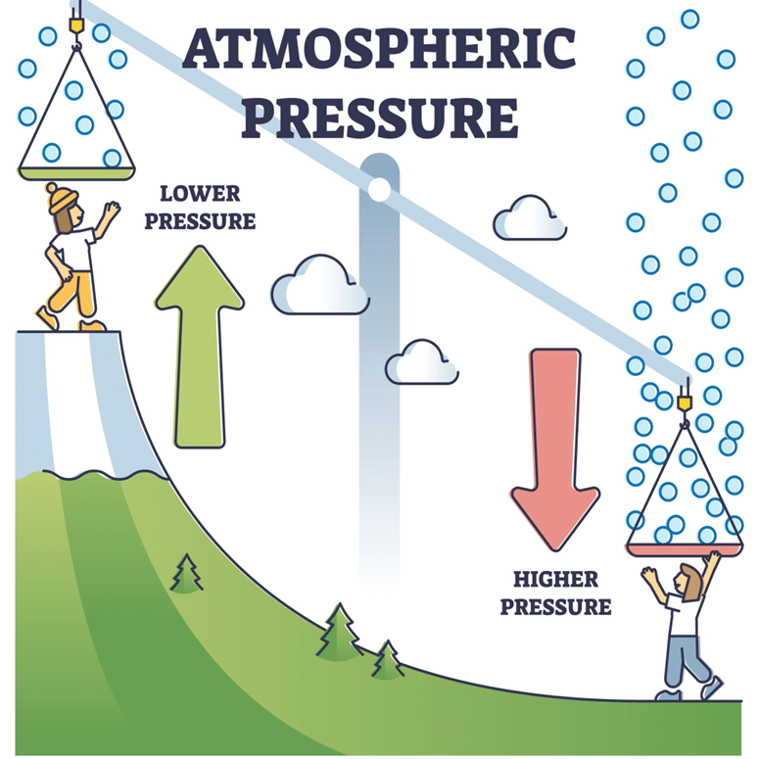
Atmospheric Pressure
Air pressure is caused by air particles colliding with surfaces.
As you go higher, the air becomes less dense.
Fewer air particles above you means less weight of air pushing down.
Therefore, atmospheric pressure decreases with height.
Notes:
Suggested exposition:
So we know that pressure increases with depth in a fluid. We can use the same idea to think about what happens when you gain altitude (get higher up).
Atmospheric pressure is caused by air molecules colliding with a surface - remember particles in fluid exert a force on any surface they collide with, including our skin or any other objects.
The higher the altitude, the less dense the atmosphere, so there are fewer air particles. This means the weight of the air decreases as you get higher up, as there are fewer particles. So atmospheric pressure decreases with height. Close to sea level, the pressure exerted by the Earth’s atmosphere is about 1.01 × 10⁵ Pa. By the time you reach an altitude of 18 000 feet, air pressure has decreased to about half of this.
An interesting way to think about this relationship:
Imagine being buried under a pile of marbles 100 km deep. Imagine the whole earth being wrapped in a 100km deep sea of marbles. Imagine how heavy that would be. Well, that's very nearly true – except the 'marbles' are so small that every breath you take contains 25 sextillion of them (that's 25 with 21 zeros after it...)
We live at the bottom of an 'ocean of air'. The molecules of air are pulled down by gravity, and so they press down against the surface of the earth, and against us, with a force that is extraordinarily strong (we just don't notice it because we evolved in it and have never experienced anything different). Just as very deep ocean waters exert enormous pressures on objects in those depths (because of the weight of all that water above), but far less pressure the higher you go towards the surface (less water above), so we experience air pressure at the 'bottom' of the 'ocean of air', and the higher we go, the less pressure there is (because there is less air above us to press down on us).

Slide 11
Atmospheric Pressure
Air pressure is caused by air particles __________ with surfaces.
As you go higher, the air becomes _________ dense.
Fewer air particles above you means _____ weight of air pushing down.
Therefore, atmospheric pressure __________ with height.
Notes:
Suggested exposition:
So we know that pressure increases with depth in a fluid. We can use the same idea to think about what happens when you gain altitude (get higher up).
Atmospheric pressure is caused by air molecules colliding with a surface - remember particles in fluid exert a force on any surface they collide with, including our skin or any other objects.
The higher the altitude, the less dense the atmosphere, so there are fewer air particles. This means the weight of the air decreases as you get higher up, as there are fewer particles. So atmospheric pressure decreases with height. Close to sea level, the pressure exerted by the Earth’s atmosphere is about 1.01 × 10⁵ Pa. By the time you reach an altitude of 18 000 feet, air pressure has decreased to about half of this.
An interesting way to think about this relationship:
Imagine being buried under a pile of marbles 100 km deep. Imagine the whole earth being wrapped in a 100km deep sea of marbles. Imagine how heavy that would be. Well, that's very nearly true – except the 'marbles' are so small that every breath you take contains 25 sextillion of them (that's 25 with 21 zeros after it...)
We live at the bottom of an 'ocean of air'. The molecules of air are pulled down by gravity, and so they press down against the surface of the earth, and against us, with a force that is extraordinarily strong (we just don't notice it because we evolved in it and have never experienced anything different). Just as very deep ocean waters exert enormous pressures on objects in those depths (because of the weight of all that water above), but far less pressure the higher you go towards the surface (less water above), so we experience air pressure at the 'bottom' of the 'ocean of air', and the higher we go, the less pressure there is (because there is less air above us to press down on us).

Slide 12
. Key Ideas (Read First)
Pressure in a liquid increases with depth.
Pressure is greater in denser liquids (like syrup vs water).
A larger area gives a larger force when pressure is the same.
Notes:
Suggested exposition:
So we know that pressure increases with depth in a fluid. We can use the same idea to think about what happens when you gain altitude (get higher up).
Atmospheric pressure is caused by air molecules colliding with a surface - remember particles in fluid exert a force on any surface they collide with, including our skin or any other objects.
The higher the altitude, the less dense the atmosphere, so there are fewer air particles. This means the weight of the air decreases as you get higher up, as there are fewer particles. So atmospheric pressure decreases with height. Close to sea level, the pressure exerted by the Earth’s atmosphere is about 1.01 × 10⁵ Pa. By the time you reach an altitude of 18 000 feet, air pressure has decreased to about half of this.
An interesting way to think about this relationship:
Imagine being buried under a pile of marbles 100 km deep. Imagine the whole earth being wrapped in a 100km deep sea of marbles. Imagine how heavy that would be. Well, that's very nearly true – except the 'marbles' are so small that every breath you take contains 25 sextillion of them (that's 25 with 21 zeros after it...)
We live at the bottom of an 'ocean of air'. The molecules of air are pulled down by gravity, and so they press down against the surface of the earth, and against us, with a force that is extraordinarily strong (we just don't notice it because we evolved in it and have never experienced anything different). Just as very deep ocean waters exert enormous pressures on objects in those depths (because of the weight of all that water above), but far less pressure the higher you go towards the surface (less water above), so we experience air pressure at the 'bottom' of the 'ocean of air', and the higher we go, the less pressure there is (because there is less air above us to press down on us).

Slide 13
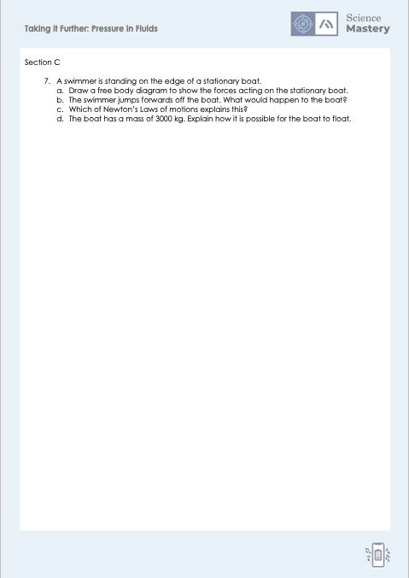
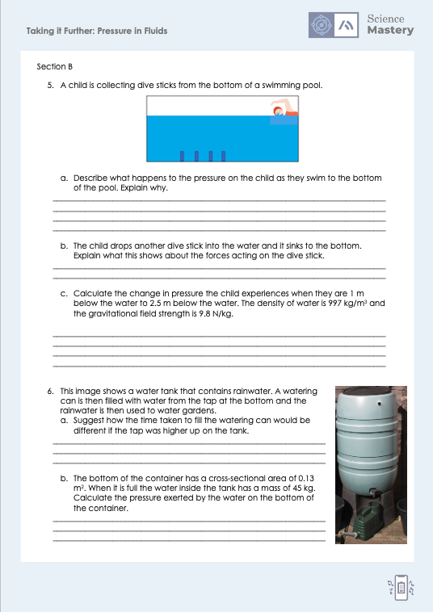
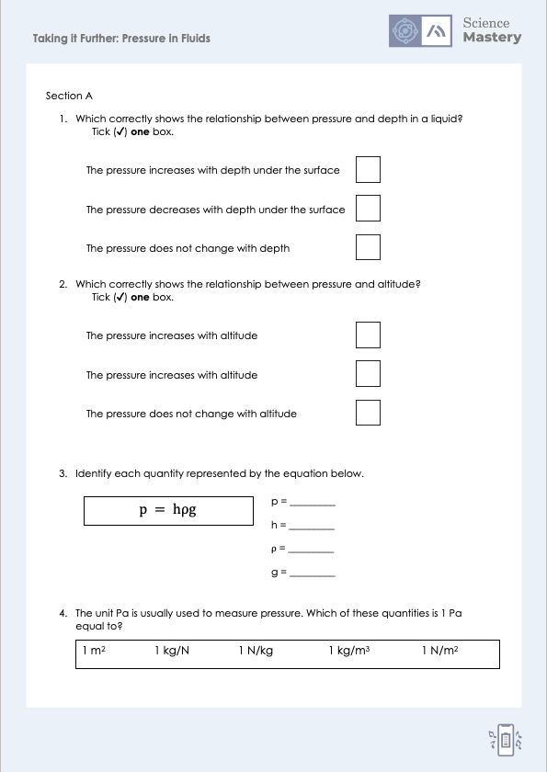
Activity

Slide 14

Answers
1. The pressure increases with depth under the surface
2. The pressure decreases with altitude
3.
p = pressure
h = height of column
$ρ$ = density
g = gravitational field strength
4. 1 N/m²

Slide 15
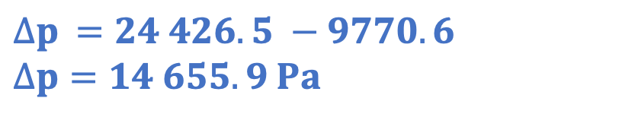
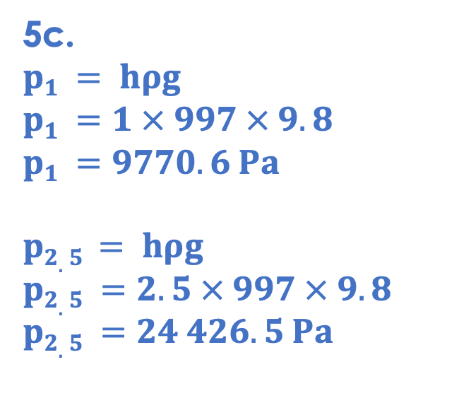
Answers
5a. The pressure increases as they swim to the bottom of the pool, because there are more water particles above the child as they swim deeper, therefore the weight of the water increases.
5b. The weight of the dive stick is greater than the upthrust
5c.
$$p1 = hρg$$
$$p1 =1 × 997 × 9.8$$
$$p1 =9770.6 Pa$$
$$p2.5 = hρg$$
$$p2.5 =2.5 × 997 × 9.8$$
$$p2.5 =24 426.5 Pa$$
$$∆p =24 426.5 −9770.6$$
$$∆p=14 655.9 Pa$$

Slide 16

Answers
6a. The watering can would take longer to fill if the tap was higher up, because the pressure of the water would be lower higher up.
6b.
$$W =mg$$
$$W =45 × 9.8$$
$$W =441 N$$
$$p = \frac{F}{A}$$
$$p = \frac{441}{0.13}$$
$$p =3 392.31 Pa$$

Slide 17
Answers
7a.
Upthrust
7b. The boat would recoil/move backwards.
7c. Newton’s Third Law. When object A exerts a force on object B, object B exerts an equal and opposite force on object A. The person exerts a force on the boat, and the boat exerts an equal and opposite force on the person.
Weight
7d. The density of the boat is lower than the density of the water.
Notes:
For 7a, the forces should be equal and opposite.

Slide 18
Answer the questions below.
A student cuts three holes in a bottle of water. Where is the pressure greatest?
A. At the highest hole
B. At the middle hole
C. At the lowest hole
✓
2. An inflatable toy floats on water. Which statement is correct?
A. The inflatable toy is more dense than the water
B. The inflatable toy does not have weight when it is on water
C. The weight of the toy is less than or equal to the upthrust on the toy
✓
3. How deep is an object under water if it experiences 29 910 N/m² of pressure? The density of water is 997 kg/m³ and the gravitational field strength is 9.8 N/kg.
A. 2.92 x 10⁸ m
B. 3.06 m
C. 3.40 x10⁻³ m
✓
Notes:
Q1. Answer: C
If students answer A or B, they have not understood the relationship between pressure acting on a point and depth of the point. To fix-it, it can be useful to review the water bottle with holes as a demo to show how the pressure affects how forcefully the water flows out.
Q2. Answer: C
If students answer B, they have confused the relationship between density and sinking/floating. To fix-it, give students a question such as ‘why does a huge plank of wood float but a marble sinks?’ . If students answer B, they have the misconception that different forces apply when in water. To fix-it, use a force diagram to get students thinking about the forces acting on an object, remembering that if the resultant force = 0, the motion of the object will not change.
Q3. Answer: B
If students answer A, they have just multiplied all the given values together. If students answer C, they have made the mistake of confusing density and pressure in the equation. To fix-it, review the equation and the meaning of each symbol, with plenty of practice calculations for students to solve for different unknowns.

Slide 19
Lesson P4.1.6
What was good about this lesson? | What can we do to improve this lesson?
Send us your feedback by clicking this link. Thank you!

